Slide 1


ABI Summer 2021 Introduction to Statistics
Guest Session 4
Javier Cabrera*, Volha Tryputsen** & Davit Sargsyan**
July 15, 2021
(*)Rutgers, the State University of New Jersey
(**)Janssen Pharmaceutical Research and Development (J&J)

Slide 2

Body Weight vs. Age
Twenty (20) mice between the age of 0 and 90 days were weighted
What is the relationship between age and weight?

Slide 3
Average Weight by Age
We can bin the mice by age, e.g., less than 1, 2 and 3 months old.
Calculate the mean weight by age in months:
Age (Months) | Mean | SEM
1 | 4.53 | 1.16
2 | 11.54 | 0.79
3 | 18.37 | 1.15
residual
Mice weight is positively associated with age (older mice weight more)

Slide 4
Line of Best Fit
Instead of binning the observation, lets try to find a relationship that we can describe with a line:
Y=a + bX
Where a is the y-intercept and b is the slope of the line
There are many lines we can draw trough the data
How do we find the best one? What does it mean – a line of best fit?

Slide 5
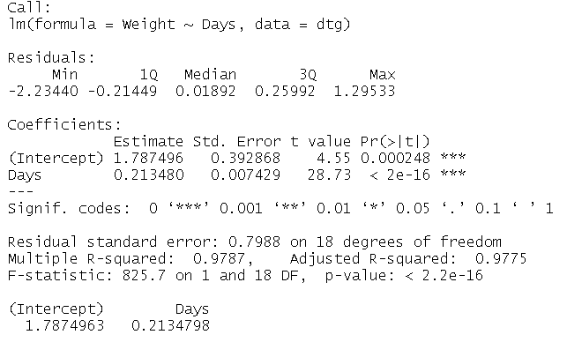
Linear Regression
We can try to find a line that will minimize the sum of squares of residuals by fitting one that looks good and change intercept (a) and slope (b) until we cannot do any better
Instead, we can solve for a and b: the method of least squares.
R output (function lm)
Y = a + b*x

Slide 6
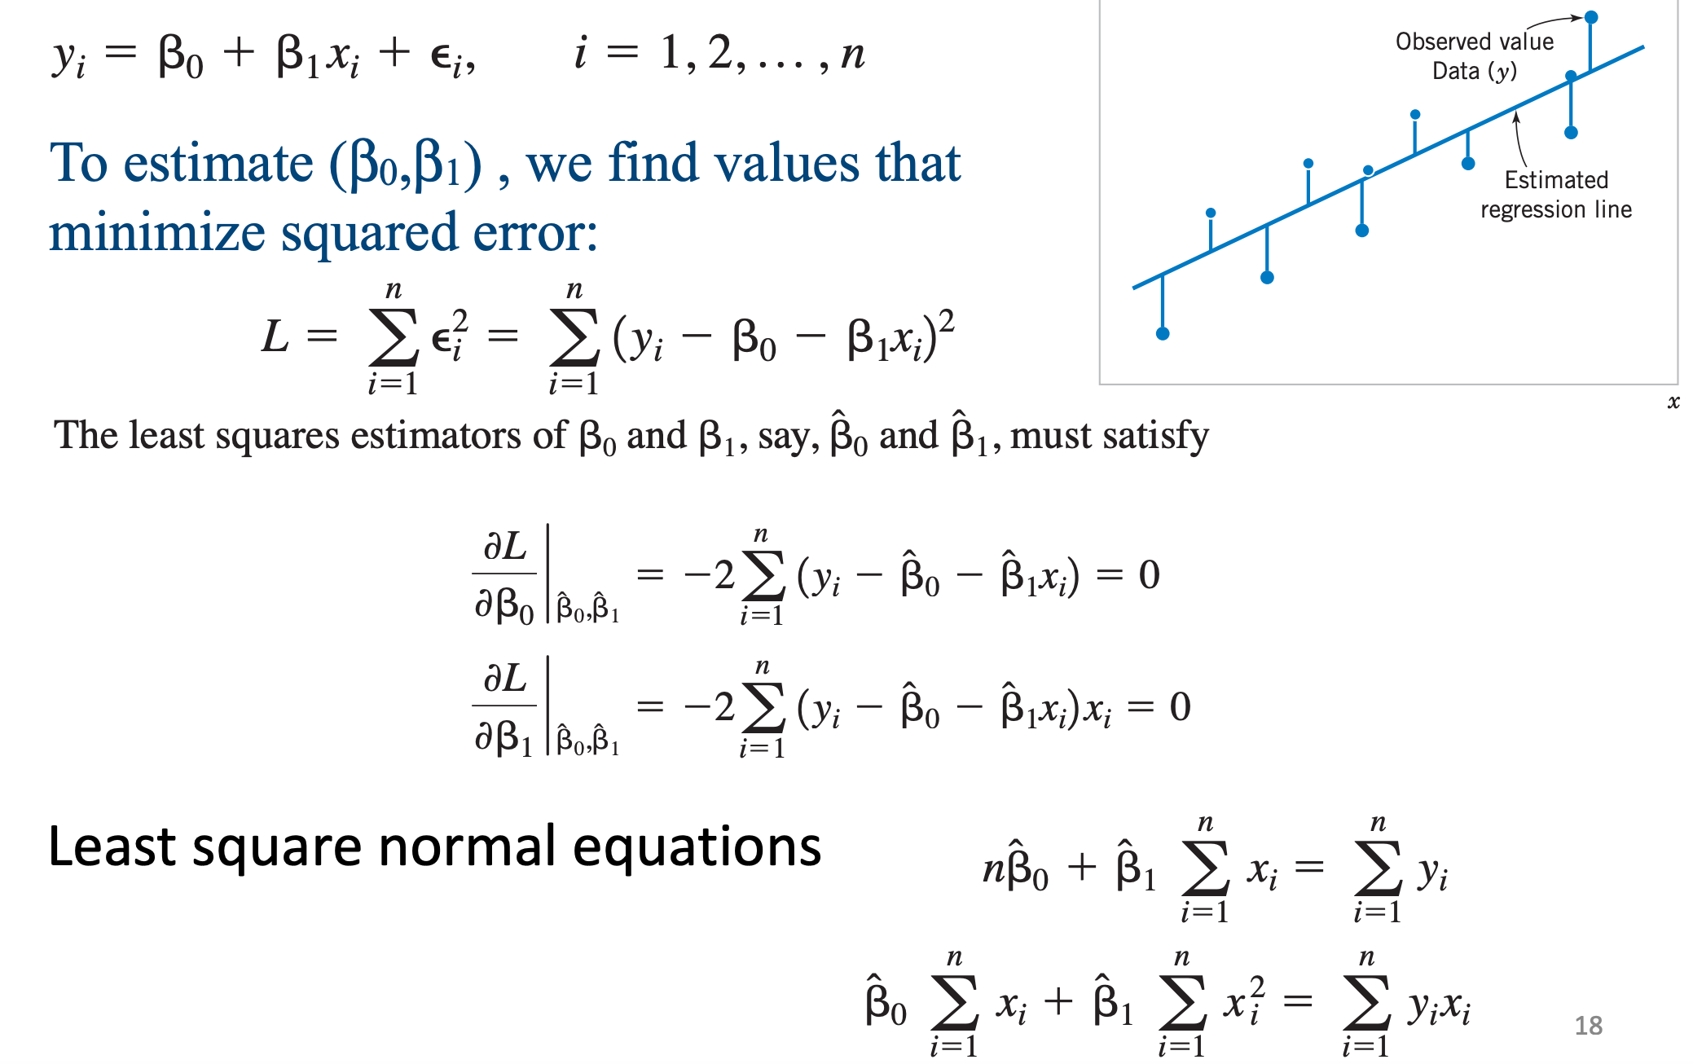
Method of least squares

Slide 7
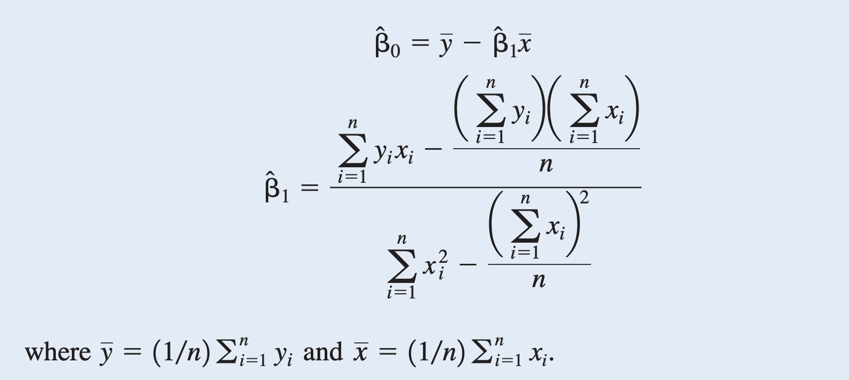
The least squares estimates of the intercept and slope in the simple linear regression model are:

Slide 8
Predicting Observations

Slide 9



3 things to remember when fitting a linear model!
3) Inference
2) Goodness of fit
1) Diagnostics

Slide 10

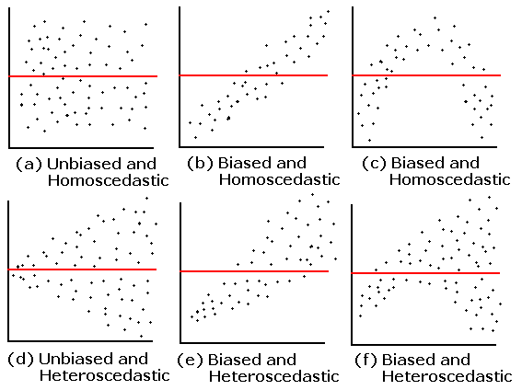
(1) Model Diagnostics: residuals vs fitted
Residuals
! If residuals are scattered randomly around 0 with uniform variation, it indicates that the data fit a linear mode!
Fitted

Slide 11

(1) Model Diagnostics: residuals vs fitted
Residuals
“Don’t stop building your model until residuals show no pattern”
-John Tukey
Fitted

Slide 12
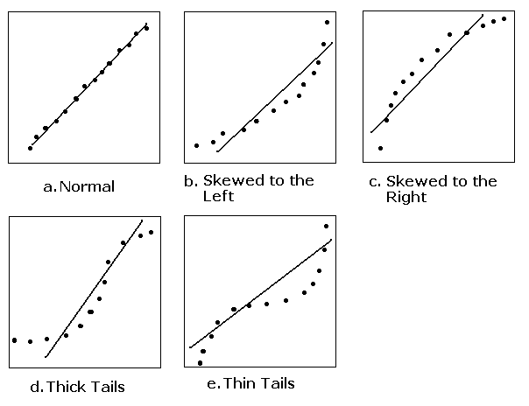
(1) Model Diagnostics: normality of residuals
qq-plot of residuals
! The line on the plot is straight, supporting the assumption of normally distributed residuals!
Notes:
A qq-plot is a plot of the quantiles of the first data set against the quantiles of the second data set. By a quantile, we mean the fraction (or percent) of points below the given value. That is, the 0.3 (or 30%) quantile is the point at which 30% percent of the data fall below and 70% fall above that value.

Slide 13
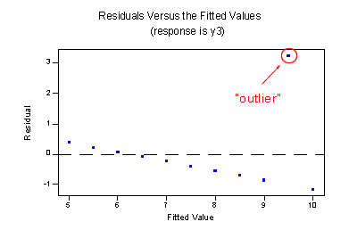
(1) Model Diagnostics: outliers
An outlier is an observation that has a large residual. In other words, the observed value for the point is very different from that predicted by the regression model.
Q: What to do when data has outliers?
A: Use robust regression!

Slide 14
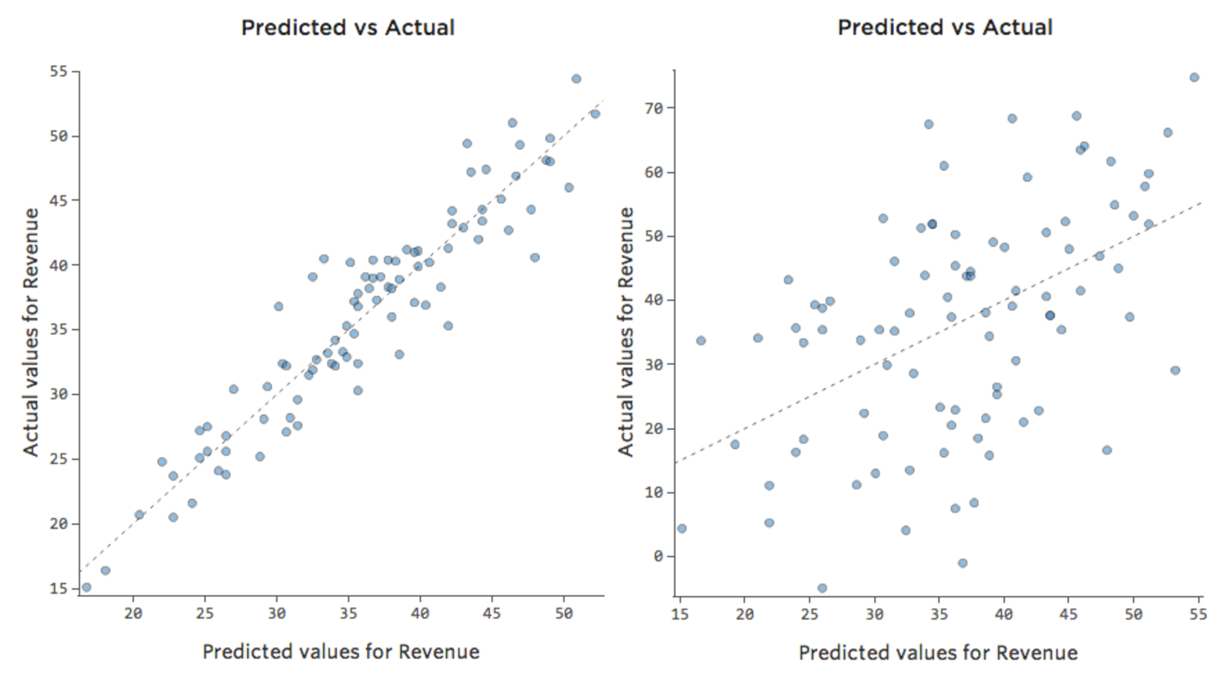
(2) Model Performance: Goodness of Fit
How well you can predict a future dataset?
R-squared is displayed in the summary(lm(y~x))
Look at the plot of predicted values vs. observed
R-squared = correlation(predicted vs. observed)^2
NOTE: even if R-squared is low but the slope is significant, model can still be very useful to establish a relationship

Slide 15
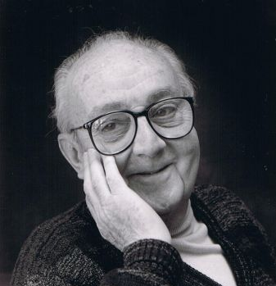
(2) Model Performance: Goodness of Fit
How well you can predict a future dataset?
R-squared is displayed in the summary(lm(y~x))
Look at the plot of predicted values vs. observed
R-squared = correlation(predicted vs. observed)^2
NOTE: even if R-squared is low but the slope is significant, model can still be very useful to establish a relationship
“All models are wrong, but some are useful”
- George Box

Slide 16
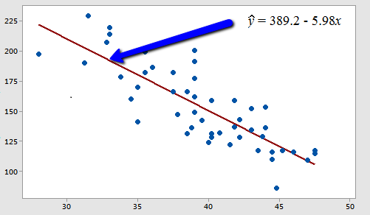
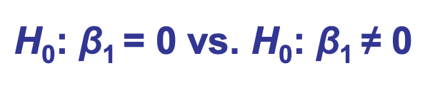
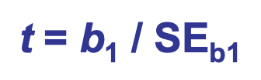
(3) Inference: Estimating the Slope
Slope
Slope of a linear regression line tells us how much change in y-variable is caused by a unit change in x-variable.
Q: Is it statistically significantly different than "zero"?
A: For that, we can test the hypothesis that the regression slope parameter β is equal to zero.
We calculate to find a p-value for the t-test of significance of the slope.

Slide 17
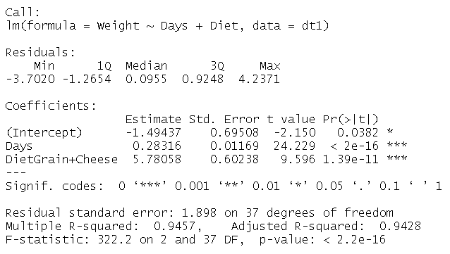
More than one predictors
Now, let’s add another variable to explain the weight difference: Diet

Slide 18
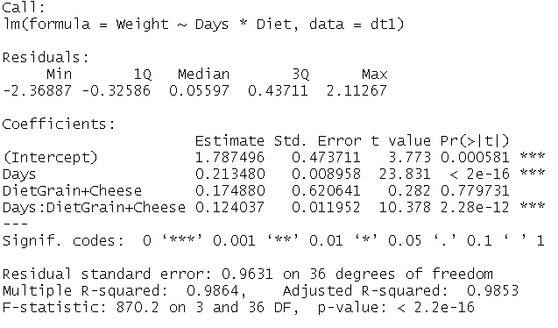
Interaction
Grain+Cheese
Grain

Slide 19
LINEAR MODEL FOR TWO FACTORS
 | exprs | probe | sample
1 | 168.68 | 1 | T1
2 | 681.18 | 2 | T1
3 | 989.18 | 3 | T1
4 | 31.22 | 4 | T1
5 | 227.18 | 5 | T1
6 | 87.18 | 6 | T1
7 | 1279.18 | 7 | T1
8 | 857.48 | 8 | T1
9 | 122.18 | 9 | T1
10 | 43.18 | 10 | T1
11 | 162.48 | 11 | T1
12 | 83.05 | 1 | T2
13 | 534.05 | 2 | T2
14 | 809.35 | 3 | T2
15 | 30.23 | 4 | T2
16 | 255.05 | 5 | T2
17 | 91.85 | 6 | T2
18 | 1279.05 | 7 | T2
19 | 1175.05 | 8 | T2
20 | 112.35 | 9 | T2
21 | 34.12 | 10 | T2
22 | 172.05 | 11 | T2
23 | 103.02 | 1 | T3
24 | 479.02 | 2 | T3
25 | 717.02 | 3 | T3
26 | 13.57 | 4 | T3
27 | 114.02 | 5 | T3
28 | 41.98 | 6 | T3
… | … | … | …
Model: Data = Tot Mean + Factor 1 Effect + Factor 2 Eff + Error
LINEAR MODEL FOR TWO WAY TABLE of gene expressions:
This is a typical dataset where we have a response and two factors:
Factor 1 is the sample and Factor 2 is the probe and we want to estimate
the sample effect .
Example: Observe the 11 probes for one gene in 6 samples

Slide 20
LINEAR MODEL FOR TWO FACTORS
summary(lm(exprs~ probe + sample,data))
Residuals:
Min 1Q Median 3Q Max
-237.84 -34.81 -9.40 41.93 260.47
Coefficients:
Estimate Std. Error t value Pr(>|t|)
(Intercept) 135.49 38.92 3.482 0.00104 **
probe2 425.58 45.63 9.326 1.59e-12 ***
probe3 717.13 45.63 15.715 < 2e-16 ***
probe4 -106.20 45.63 -2.327 0.02405 *
probe5 65.50 45.63 1.435 0.15741
probe6 -43.36 45.63 -0.950 0.34663
probe7 994.52 45.63 21.794 < 2e-16 ***
probe8 743.27 45.63 16.288 < 2e-16 ***
probe9 -28.01 45.63 -0.614 0.54215
probe10 -92.08 45.63 -2.018 0.04899 *
probe11 15.38 45.63 0.337 0.73745
sampleC2 16.49 33.70 0.489 0.62684
sampleC3 -73.26 33.70 -2.174 0.03448 *
sampleT1 42.45 33.70 1.260 0.21368
sampleT2 35.82 33.70 1.063 0.29295
sampleT3 -64.30 33.70 -1.908 0.06216 .
---
Signif. codes: 0 ‘***’ 0.001 ‘**’ 0.01 ‘*’ 0.05 ‘.’ 0.1 ‘ ’ 1
Residual standard error: 79.04 on 50 degrees of freedom
Multiple R-squared: 0.969, Adjusted R-squared: 0.9597
F-statistic: 104.3 on 15 and 50 DF, p-value: < 2.2e-16
Fitted model: Data = Total Sample Effect + Probe Effect + Residual
= (Intercept + sample )+ Probe Effect + Residual
Condition: probe effects need to add up to zero
(Intercept) probe2 probe3 probe4 probe5 probe6 probe7 probe8 probe9 probe10
135.49 425.58 717.13 -106.20 65.50 -43.36 994.52 743.27 -28.01 -92.08
probe11 sampleC2 sampleC3 sampleT1 sampleT2 sampleT3
15.38 16.49 -73.26 42.45 35.82 -64.30

Slide 21
LINEAR MODEL FOR TWO FACTORS
Fitted model: Data = Total Sample Effect + Probe Effect + Residual
= (Intercept + sample )+ Probe Effect + Residual
Condition: probe effects need to add up to zero
(Intercept) probe2 probe3 probe4 probe5 probe6 probe7 probe8 probe9 probe10
135.49 425.58 717.13 -106.20 65.50 -43.36 994.52 743.27 -28.01 -92.08
probe11 sampleC2 sampleC3 sampleT1 sampleT2 sampleT3
15.38 16.49 -73.26 42.45 35.82 -64.30
sampleExpresLS = b[1] + c(sampleC1=0,b[12:16])
probeEffects = c(probe1=0,b[2:11])
mean(probeEffects) [1] 244.7035
(sampleExpresLS =sampleExpresLS + mean(probeEffects))
sampleC1 sampleC2 sampleC3 sampleT1 sampleT2 sampleT3
380.1973 396.6845 306.9355 422.6473 416.0182 315.8982
(probeEffects =probeEffects - mean(probeEffects))
probe1 probe2 probe3 probe4 probe5 probe6 probe7 probe8 probe9 probe10 probe11
-244.7035 180.8798 472.4298 -350.9002 -179.2035 -288.0602 749.8132 498.5632 -272.7118 -336.7868 -229.3202
t.test(sampleExpresLS[1:3], sampleExpresLS[4:6])
t = -0.53359, df = 3.8138, p-value = 0.6232
mean of x mean of y
361.2724 384.8545

Slide 22
Median Polish
Estimate the median rather than the mean
- Robust to outliers (Remember that Least Squares is not robust to outliers.)
Median Polish model : Data = Tot Median + Row Effect + Col Eff + Residual
Fitted model: Data = Total Sample Effect + Probe Effect + Residual
Total Sample Effect = Tot Median+ Col Effect
ALGORITHM FOR MEDIAN POLISH: Estimate Row Col and Tot effects using medians.
- Alternate iteration of removing the medians of rows and columns
- Continue iteration until reduction is less than a constant in sum of residual squares or absolute residuals

Slide 23
To run Median Polish, use the medpolish function on R
mp = medpolish(dat)
Overall: 148.7713
Row Effects:
1 2 3 4 5 6 7 8 9 10 11
-4.3975 416.8688 678.5188 -125.7012 51.8725 -59.1175 1050.9000 669.5225 -38.3225 -110.8350 0.0000
Column Effects:
C1 C2 C3 T1 T2 T3
3.65375 -2.19625 -31.96375 24.30625 2.19625 -47.67375
Residuals:
C1 C2 C3 T1 T2 T3
1 -10.9475 23.7425 0.000 0.000 -63.5200 6.3200
2 33.7863 41.9762 -112.766 91.234 -33.7863 -38.9463
3 20.1363 156.3262 -70.416 137.584 -20.1363 -62.5963
4 -6.9638 -4.9638 31.184 -16.156 4.9638 38.1737
5 32.7825 -5.0275 -32.270 2.230 52.2100 -38.9500
6 -15.7275 40.7625 25.520 -26.780 0.0000 0.0000
7 9.2550 -9.2550 -348.797 55.203 77.1825 -192.6775
8 -62.5675 -17.6775 -15.420 14.880 354.5600 97.9000
9 -29.7225 2.1675 31.225 -12.575 -0.2950 0.2950
10 0.0000 0.0000 34.738 -19.063 -6.0125 32.0575
11 6.1550 -6.1550 19.103 -10.598 21.0825 -8.0775
To Calculate the samples gene expressions, add the overall median to the column effects
sampleExpresRob = mp$overall+ mp$col

Slide 24
Median Polish
We compare now the samples expressions obtain from LS
and Median Polish. The results show a big difference.
sampleExpresLS
sampleC1 sampleC2 sampleC3 sampleT1 sampleT2 sampleT3
380.1973 396.6845 306.9355 422.6473 416.0182 315.8982
sampleExpresRob
C1 C2 C3 T1 T2 T3
152.4250 146.5750 116.8075 173.0775 150.9675 101.0975
We calculate the sum of squares differences standardized and in Percent.
SSdiff = sum((sampleExpresRob-geneEffects)^2)/sum(sampleExpresRob^2)*100
[1] 271.377
This is clear evidence that the gene has many outliers.
If the gene expressions don’t have outliers, we expect Ssdiff < 25%

Slide 25
Median Polish
Homework:
The dataset probdata.csv contains probe expressions of 1100 probes for 6 samples. The probes 1100 correspond to 100 different genes, 11 probes per gene. For each of the 100 genes:
1. Calculate the LS expressions using the lm function as above
2. Calculate the Robust expressions using the medpolish function as above
3. Calculate the SSdiff statistic as above and calculate the proportion of genes that don’t have outliers in the sense that Ssdiff is less than 25%

Slide 26
Class exercise (if there is time) or a homework
 | Body Weight (kg) | Brain (g)
Mountain beaver | 1.35 | 8.1
Cow | 465 | 423
Grey wolf | 36.33 | 119.5
Goat | 27.66 | 115
Guinea pig | 1.04 | 5.5
Dipliodocus | 11700 | 50
Asian elephant | 2547 | 4603
Donkey | 187.1 | 419
Horse | 521 | 655
Potar monkey | 10 | 115
Cat | 3.3 | 25.6
Giraffe | 529 | 680
Gorilla | 207 | 406
Human | 62 | 1320
African elephant | 6654 | 5712
Triceratops | 9400 | 70
Rhesus monkey | 6.8 | 179
Kangaroo | 35 | 56
Golden hamster | 0.12 | 1
Mouse | 0.023 | 0.4
Rabbit | 2.5 | 12.1
Sheep | 55.5 | 175
Jaguar | 100 | 157
Chimpanzee | 52.16 | 440
Rat | 0.28 | 1.9
Brachiosaurus | 87000 | 154.5
Mole | 0.122 | 3
Pig | 192 | 180
Brain size vs. body mass (MASS::Animals)

Slide 27
Class exercise (if there is time) or a homework
Use: transformations, outliers (justify!), lm, correlation, …

Slide 28
References
https://www.statlearning.com/

